Slide 1
Announcements…

Slide 2
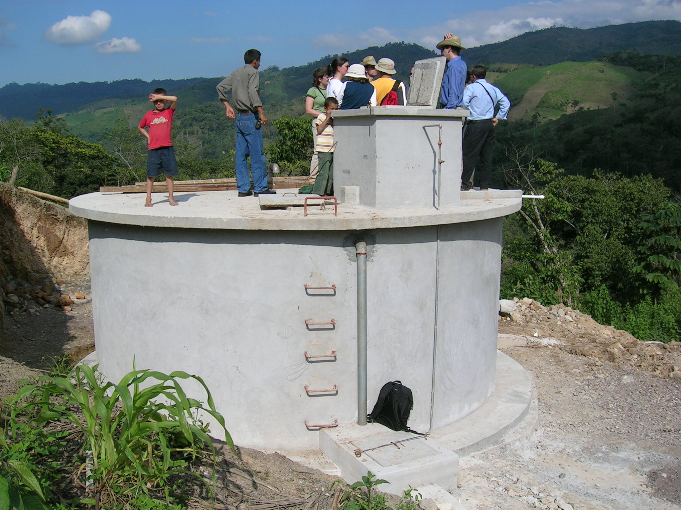
Engineers Without Frontiers

Slide 3
Lab Etiquette
Use label tape to create labels (don’t write on the plasticware)
Remove the label tape when you are finished
Make sure you dispose of any reagents
Clean up the balance bench (and any other spills right away)

Slide 4
Office hours in ACCEL or HO 150?
Wednesday 7:30 – 8:30

Slide 5
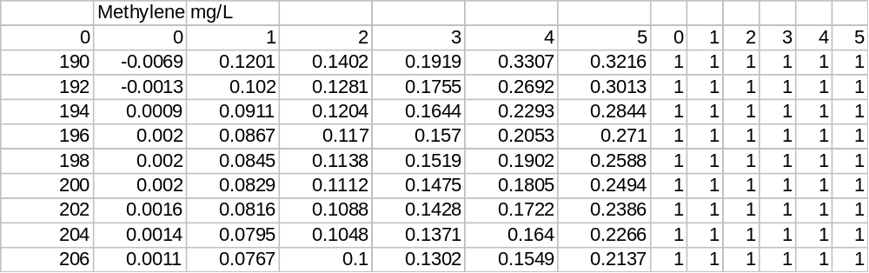
Spectrophotometer data analysis
Beware of text files that look like Excel files!
What is the “slope function” in Excel?

Slide 6
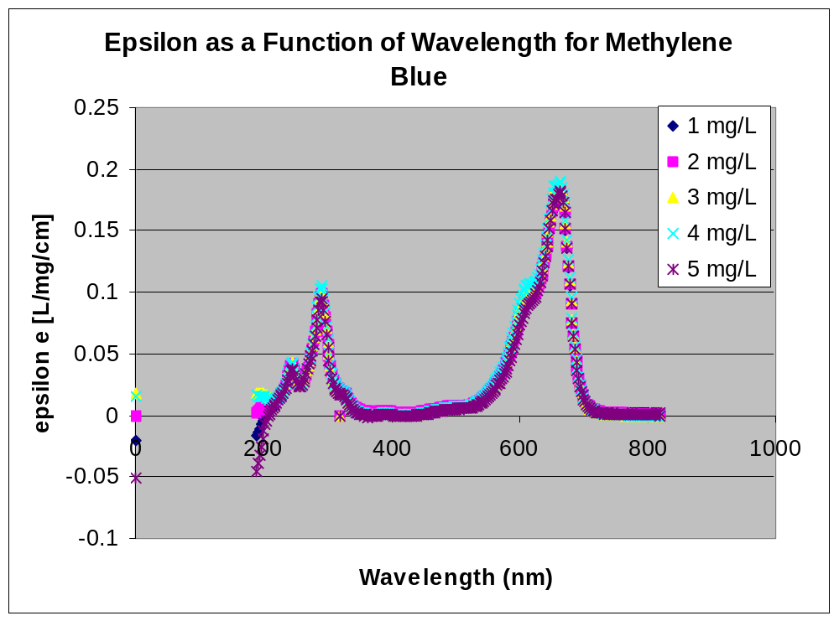
Better graphs:
How could you make this better?

Slide 7
Miscellaneous
What are the units of standard deviation?
What are the units of coefficient of variation?
“Reasonableness” of your answers
Careful with units (factors of 1000)
Did you answer all of the questions including conclusions and suggestions for the Fundamentals lab?

Slide 8
Assignments
When is this week’s assignment due?
What do you need to turn in?
Individually or in Teams?

